Slide 1
Lecture No. 15 Metal Finishing
At the end of this lecture, student will be able to:
Describe methods of preparation of surface
Explain Chromium plating process
Discuss the Gold plating process and its applications

Slide 2
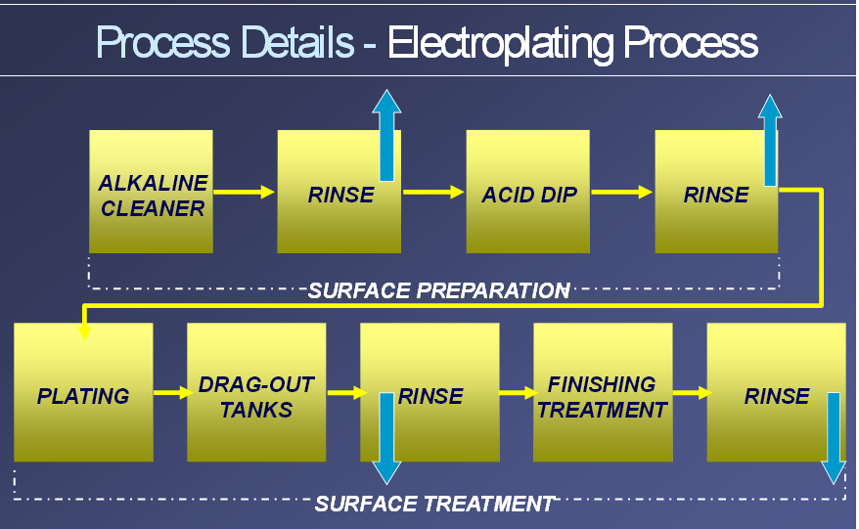
Electroplating Process

Slide 3
Methods of Cleaning the Metal Surface
A good adherent deposit is obtained only if the base metal surface is free from dirt and extraneous matter
Following methods are employed to clean the metal surfaces
Solvent cleaning: To dissolve oils and greases
Eg: CCl₄,CH₂Cl₂,CHCl=CCl₂
Alkali cleaning: To remove minute organic residues
Eg: NaOH,Na₂CO₃,Na₃PO₄
Mechanical Cleaning: Involves removal of the oxide layer or rust and other inorganic deposits
Eg: Impact tools like sandpaper, chisels, knife scrapers, wire brushes etc.

Slide 4
Methods of Cleaning the Metal Surface
Pickling: Removal of oxide films(Rust) by means of an acid
Eg: 10--30% sulphuric acid is used for this acid dip. It is again rinsed with hot water
Electropolishing: Metal to be cleaned is made as anode in a suitable acid solution
A surface layer of the metal gets dissolved along with the impurities
Helps to remove surface irregularities
Metal is then thoroughly rinsed with water, dried and used for electroplating

Slide 5
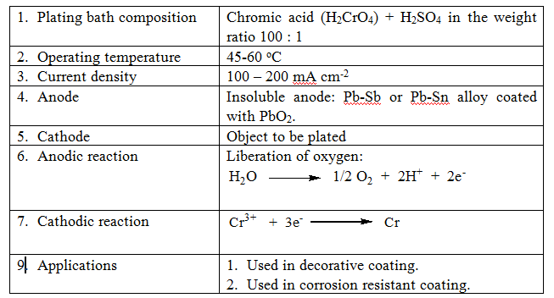
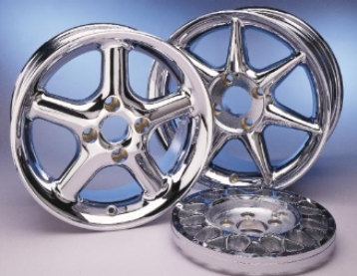
Chromium Plating
Cr₂O₃

Slide 6
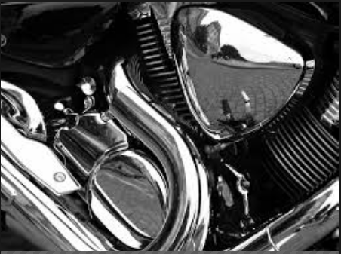
Chromium Plating
Why chromium cant be used as anode?
Chromium metal passivates strongly in acid sulphate medium
Chromium anode gives rise to Cr (III) ions on dissolution
In presence of large concentration of Cr (III) ions, a black Cr deposit is obtained (unwanted)
Hard Chrome Plating

Slide 7
Applications
Better appearance
Protection against corrosion
To achieve desired engineering effect
Plating on non-metallics
Electroforming

Slide 8
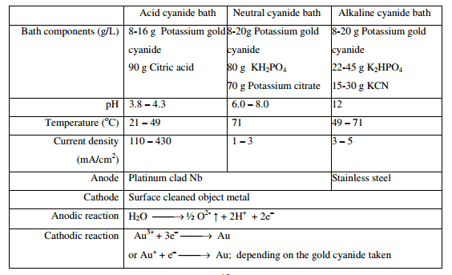
Gold Plating
K[Au(CN)₂]

Slide 9
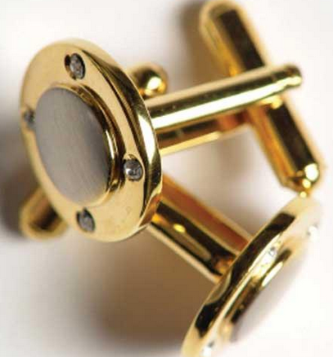
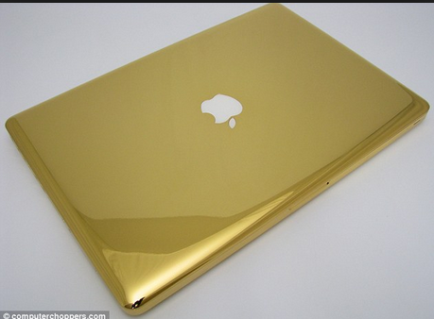
Gold plating
Plated gold edge connectors
How to Gold Plate - simple and easy gold plating

Slide 10
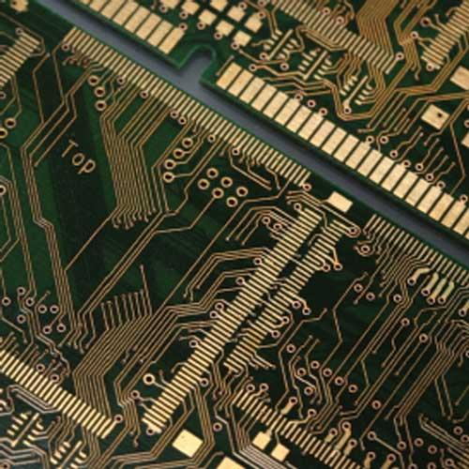
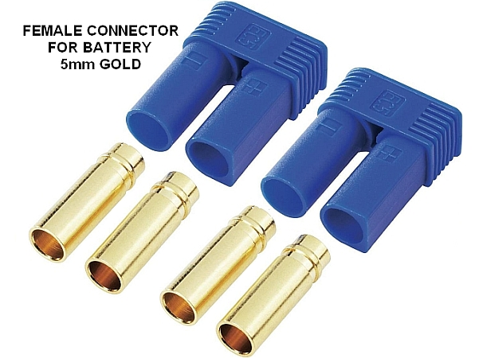
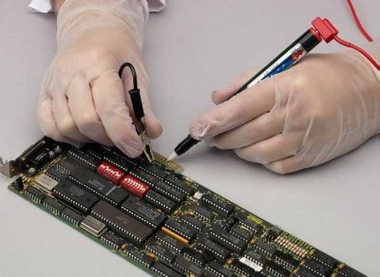
Applications
Semiconductors (Alkaline cyanide and neutral cyanide baths)
Contacts / Connectors (acid cyanide bath)
Printed/etched circuits (acid cyanide bath)

Slide 11
Summary
Methods of preparation of surface: Alkali cleaning, acid pickling, mechanical polishing, etc.
Chromium plating process: Chromic acid and H₂SO₄ in the ratio of 100:1 with current density 100-200 mAcm⁻²
Gold plating process and its applications: Acid cyanide, alkali cyanide or neutral cyanide bath, used in semiconductors, connectors, etc.

